Slide 1
Chord (P2P)
Evan Srock
Ethan Mahintorabi
Harvey Hartwell

Slide 2
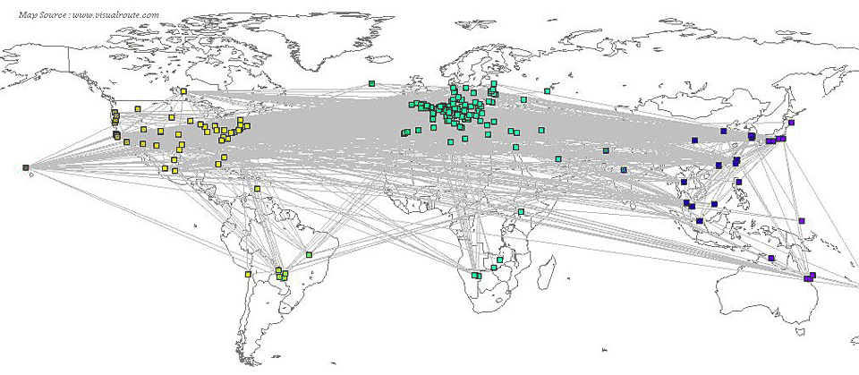
Topology

Slide 3
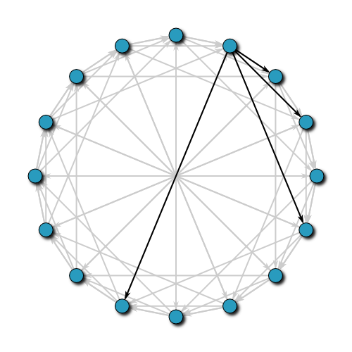
Real Topology (Overlay Network)

Slide 4
Overview

Slide 5
Fingers

Slide 6
Joining

Slide 7
Stabilization and Leaving

Slide 8
Efficiency

Slide 9
Compared to Others

Slide 10
Demonstration

